Slide 1
Time series Forecasting
- Shivani jeevan

Slide 2
Tasks done on the first Assignment
The time series data was thoroughly explored and analysed to identify patterns inherent in real-world time series data. The findings were documented, and a comprehensive technical report was prepared, incorporating informative graphs to substantiate key arguments.
Upon examination, the dataset revealed an additive trend and multiplicative seasonality, with an additional weekly seasonality identified through rigorous analysis. Statistical tests were employed to supplement visual analysis, facilitating the interpretation of results and addressing any discrepancies. Autocorrelation function (ACF) and partial autocorrelation function (PACF) graphs were generated and examined.
In conclusion, a summary of patterns observed across all individual time series within the group was provided. Commonalities and differences among the time series patterns were analyzed, considering their similarity or dissimilarity, and implications for the automated forecasting of similar time series data were discussed.

Slide 3
Tasks done on the Second Assignment
Constructed and evaluated seven forecasting models, including exponential smoothing, ARIMA, linear regression, and neural networks.
Assessed model performance using metrics such as RMSE, MAE, MAPE, AIC, and BIC, alongside time series cross-validation techniques.
Compared model performance against Naïve and Seasonal Naïve models to determine the best-fit model for forecasting ATM withdrawal data.

Slide 4
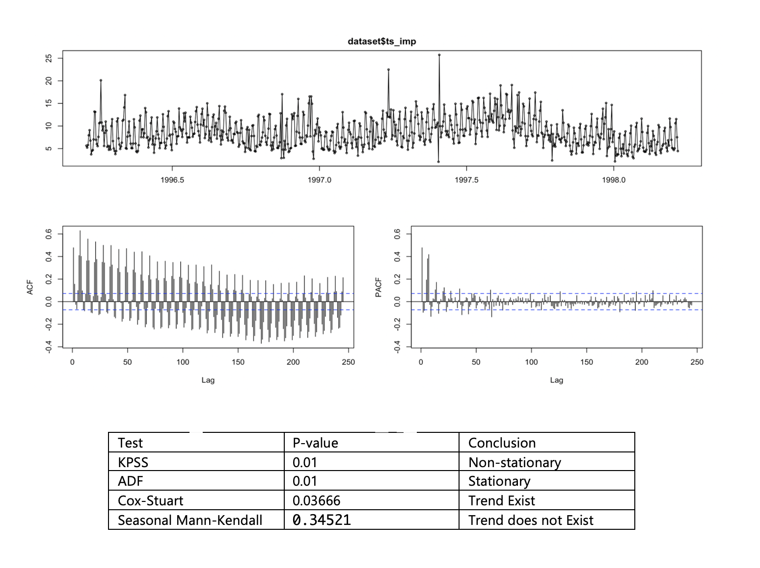
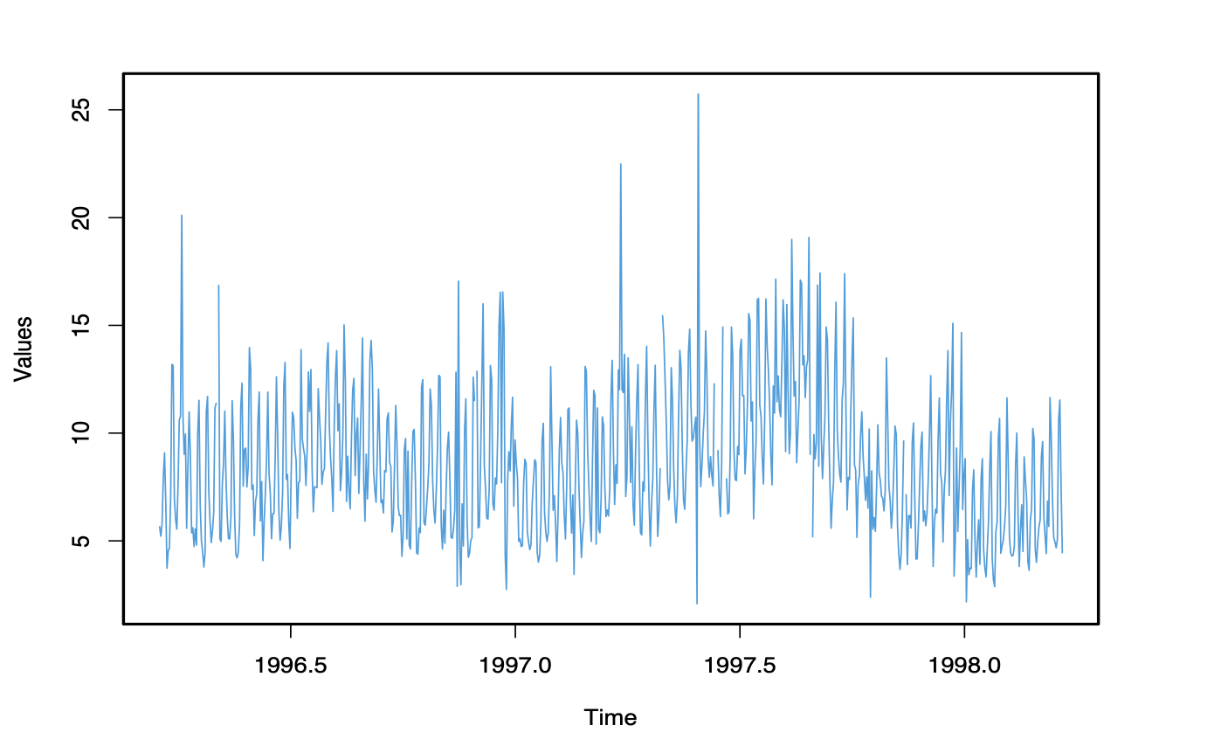
Time series

Slide 5
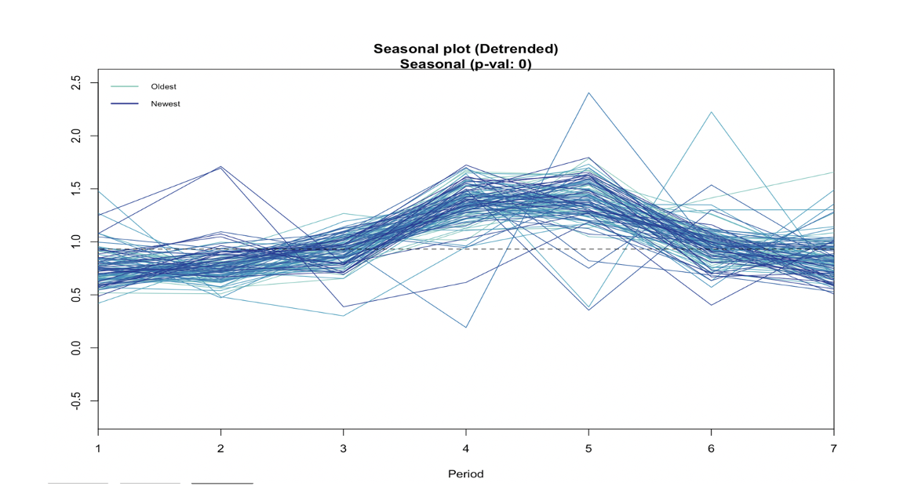
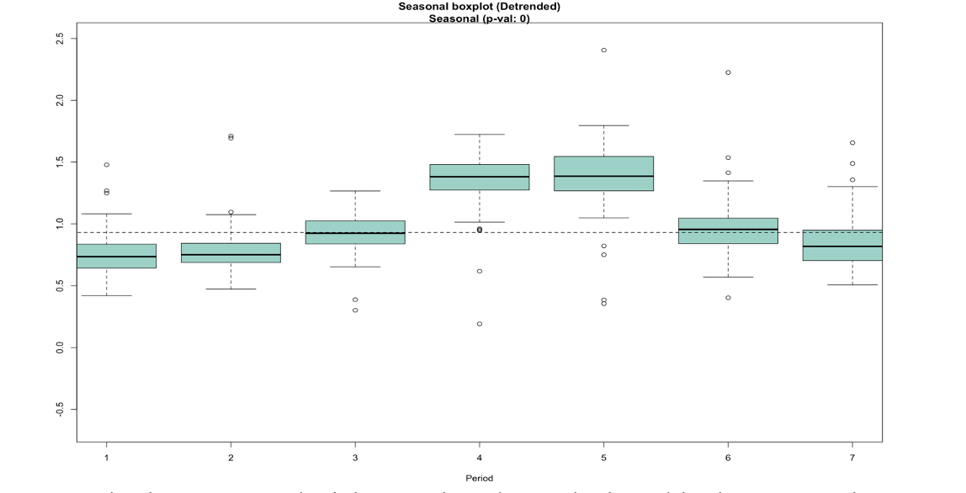
Presence of seasonality

Slide 6
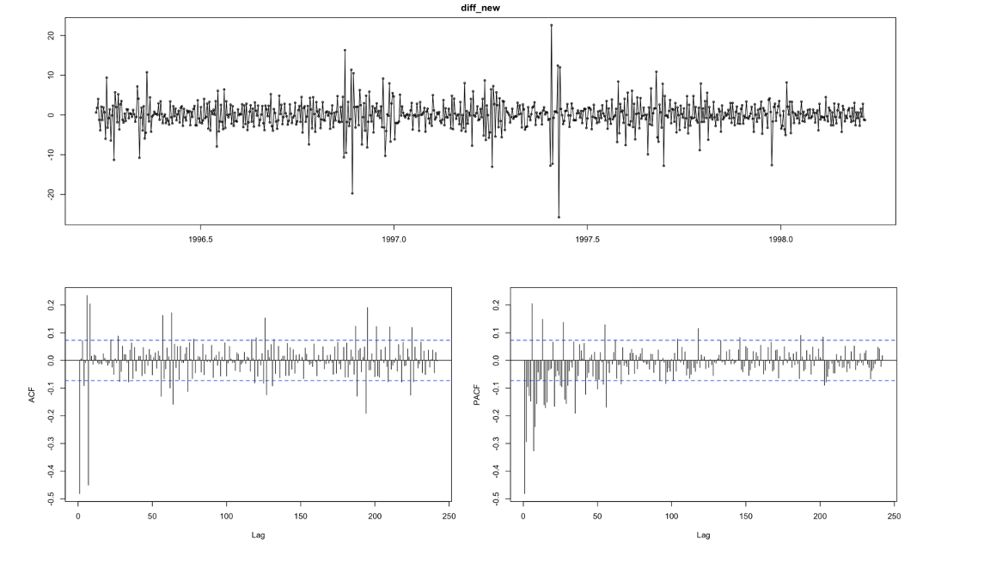
ACF / PACF analysis
First-order differencing was applied to the time series with a lag of 1 to remove any trend. Then, the seasonal component was estimated by analyzing the data with a lag of 7 to identify recurring patterns. Subsequently, the ACF and PACF plots of Series were analyzed. The ACF plot suggests potential non-stationarity in the data, while the PACF plot reveals significant lags occurring at intervals of 7, with a decreasing level of significance.

Slide 7
Model building
7 models were developed, consisting of 2 exponential smoothing, 2 ARIMA, 2 regression, and one neural network model.
A manual exponential smoothing model was created using ETS, while the automatic model building involved a grid search to determine optimal alpha, beta, and gamma values.
The ARIMA modelling process resulted in the creation of two models. One was manually specified with ARIMA parameters, whereas the other underwent an automatic grid search to identify the best values for p, d, and q.
Two linear regression models were created. One was manually constructed employing traditional regression methodologies, while the other underwent an automated optimization process, utilizing a grid search to identify the most effective combination of features and regularization parameters.

Slide 8
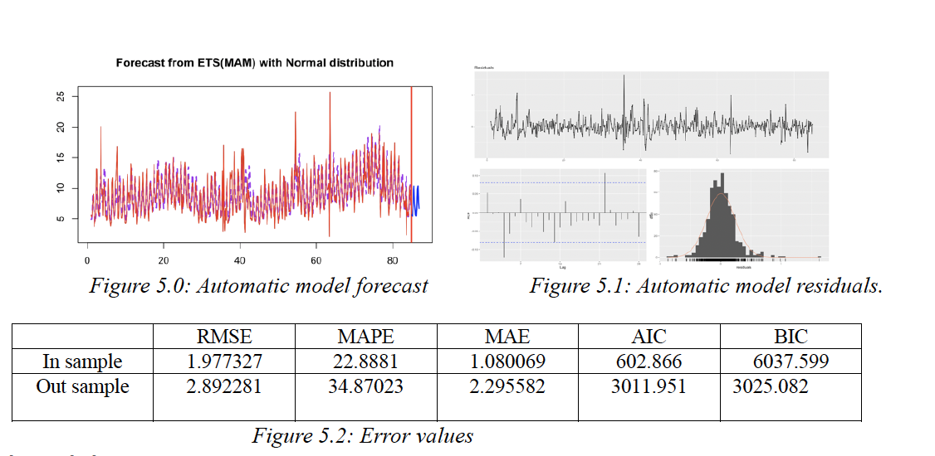
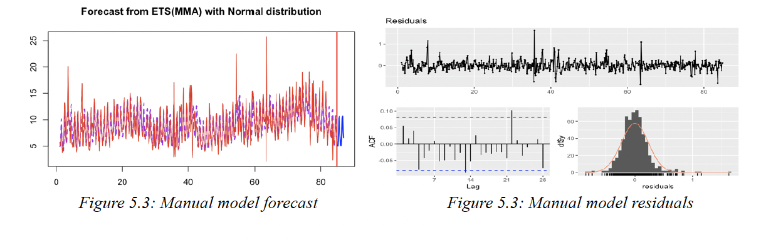
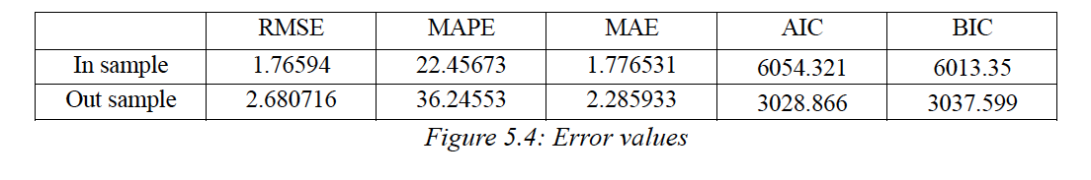
Exponential smoothing
Automatic model
Manual model

Slide 9
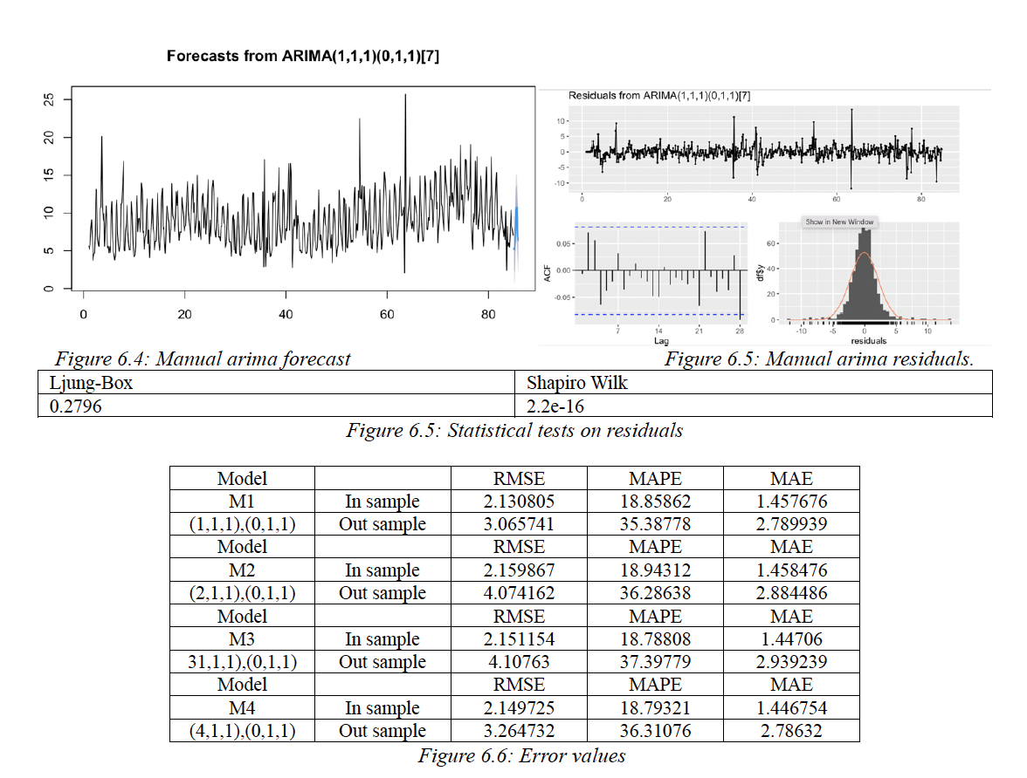
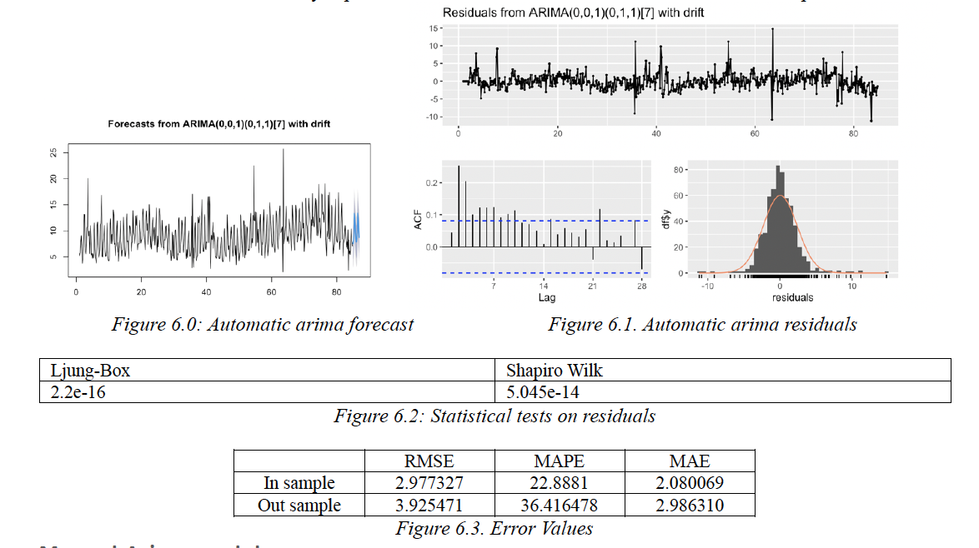
Arima smoothing
Automatic model
Manual model

Slide 10
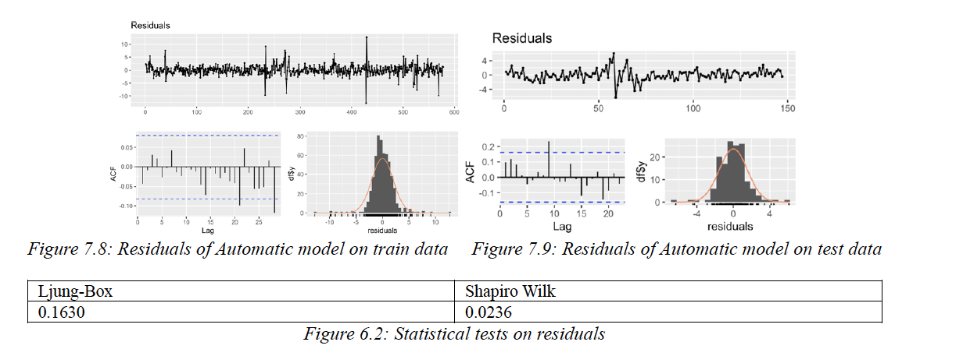
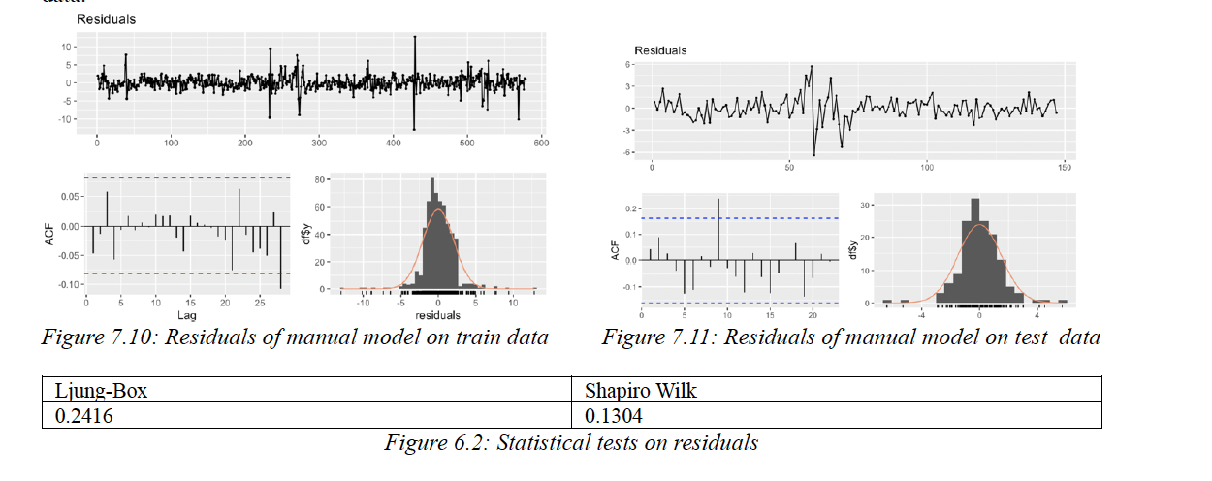
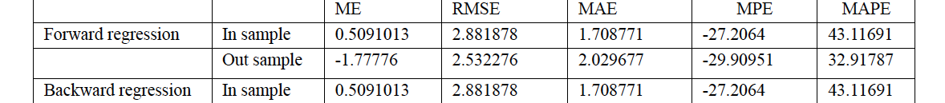
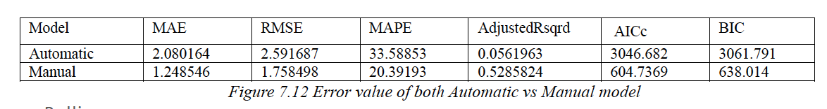
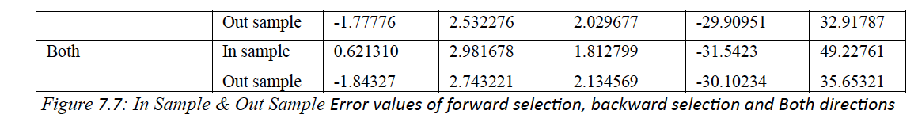
Regression model
Automatic model
Manual model

Slide 11
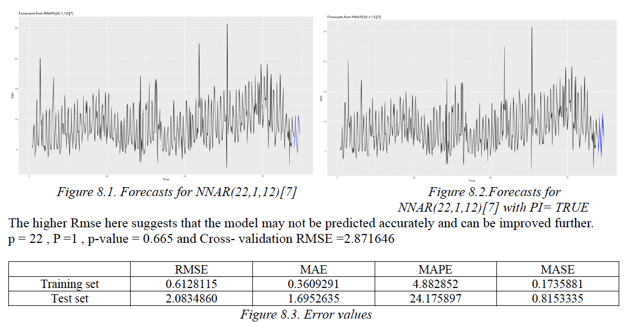
Neural Network

